Slide 1
Sensor a
Sensor b
Pulse signal
Direction signal
PSoC microprocessor
vdd
gnd
Magnet location input

Slide 2
Data on magnets location
vdd
gnd
LEDs

Slide 3
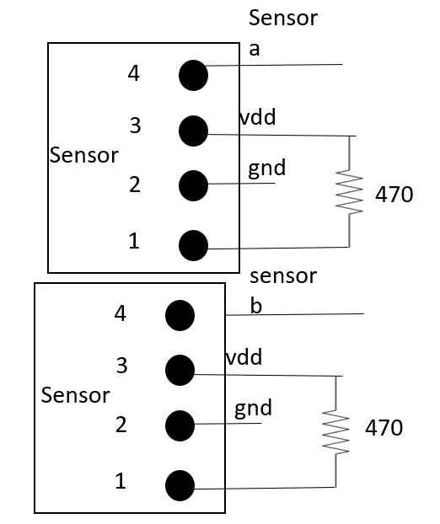
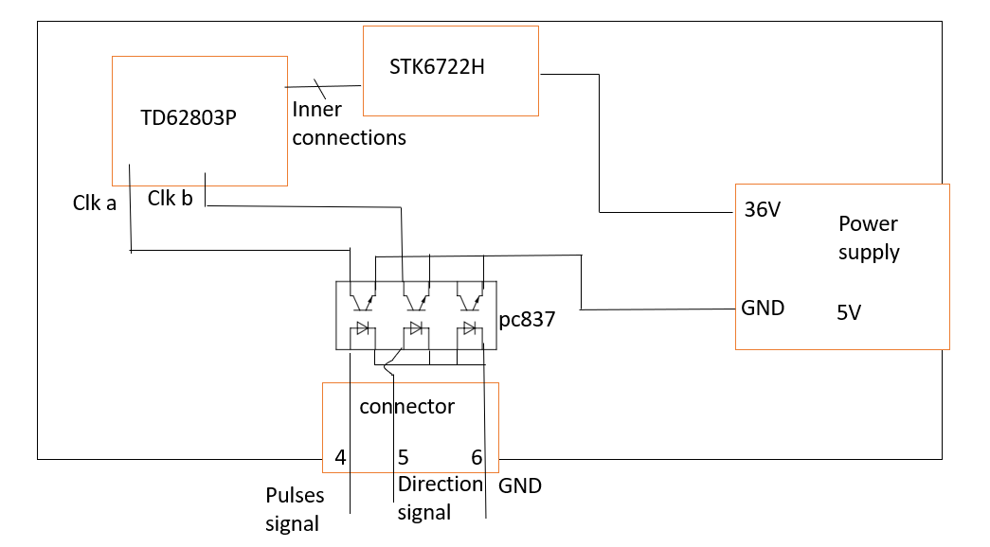
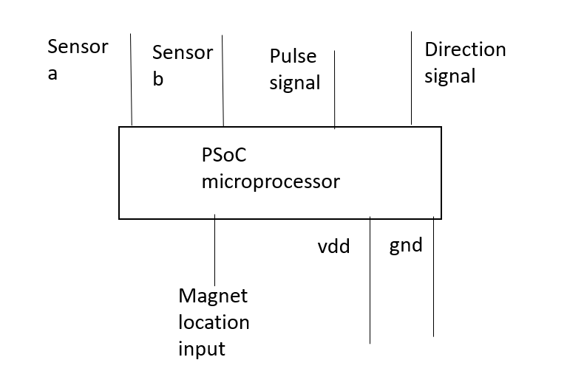
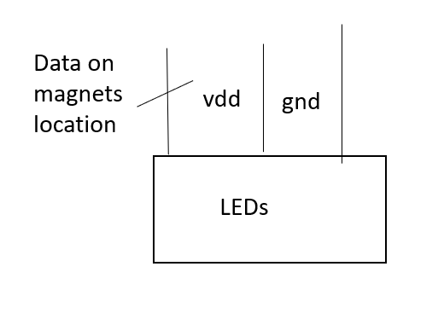
Data on magnets location

Slide 4
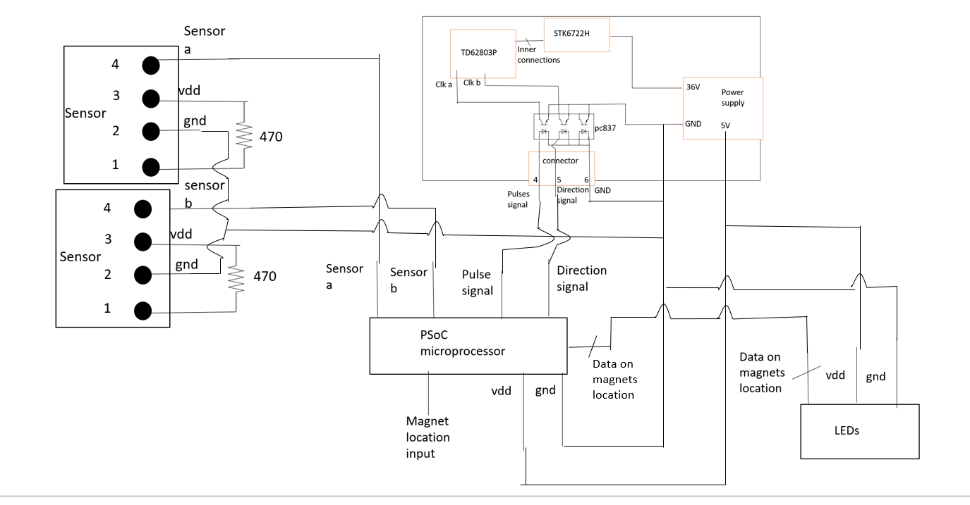
Step motor
Step motor input

Slide 5

Sensor a
4
3
vdd
Sensor
gnd
2
470
1
sensor
b
4
3
vdd
Sensor
gnd
2
470
1

Slide 6

Temp card
STK6722H
TD62803P
Inner
connections
Clk a
Clk b
36V
Power supply
pc837
GND
5V
connector
4
5
6
Pulses signal
Direction signal
GND

